Slide 1


Introduction
John Horn

Slide 2
Overview of course
Name
John
Not “professor,” or “sir,” or …
Structure
No cold-calling (but still bring name-cards)
Follow the C-Suite
Additional readings on Canvas
Podcast episodes available
Rules
Only use tablets/computers to take notes
All assignments are INDIVIDUAL – except for case submissions

Slide 3

Comfort with microeconomics

Slide 4
Agenda
Microeconomics
Demand
Supply
Competitive Markets

Slide 5




How to approach our course
Heart drives
(Passion)
Head is intellect
(Analytics)
Hands are math
(Execution)
Notes:
https://thenounproject.com/icon/heart-17448/
https://thenounproject.com/icon/thinking-1061269/
https://thenounproject.com/icon/gloves-3360490/

Slide 6

We will use math!!!
Algebra?!?
Business decisions involve “unknowns” – variables (x, y)
“Golden rule”
Whatever you do on the left, do on the right
Khan Academy

Slide 7
What is microeconomics?
Scarcity
“You can’t always get what you want …”
Optimization
Each individual (consumers and firms) doing the best for themselves
Value
The net benefit individuals are trying to optimize
Equilibrium
The outcome we get (or expect) in the economy
Markets
Where individuals trade to create value and where equilibria are observed

Slide 8
Scarcity
1
Funding
E.g., income, equity, debt, fundraising, taxes/debt
Tangible resources
E.g., minerals, agricultural products
Intangible resources
E.g., time, attention, knowledge

Slide 9
Optimization
2
Goal
What objective are you trying to achieve?
Constraints
Scarcity!

Slide 10
Value: A framework for optimal decision-making
3
x
B(x)
C(x)
An activity level
Output
Amount of time studying
Total benefits you receive from activity at level x
Revenues
Grade
Total costs you incur from activity at level x
Wages
Time spent away from family

Slide 11
Value: The objective
3
Goal is to choose x to:
max {B(x) – C(x)}
We can call B(x) – C(x) the “value”
Consumers
More benefits (e.g., happiness, utility) for the same price: better value
Same benefits, but a lower price: better value
Producers
More revenue for the same costs: create value
Same revenue, but lower costs: create value

Slide 12
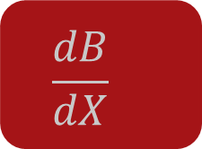
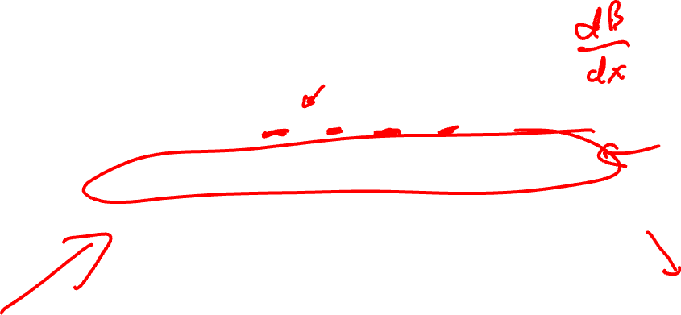
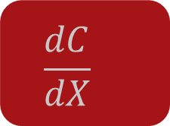

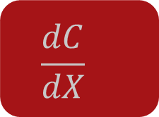
Value: The optimization
3
Choose x to:
max {B(x) – C(x)}
The value of x (denoted x*) that solves this problem:
MB(x*) = dB(x*)/dx = dC(x*)/dx = MC(x*)
Marginal benefit (MB) = marginal cost (MC)
MB > MC?
MB < MC?
$$\frac{dB}{dX}$$
$$\frac{dC}{dX}$$
$$\frac{dB}{dX}$$
$$\frac{dC}{dX}$$
X
X

Slide 13
Example: Choosing to pursue your MBA
Construct a model of the decision to get an MBA
What are the benefits?
What are the costs?
How did you construct your choice model prior to coming to Olin?

Slide 14
Implications of the model of MBA choice
When should you pursue an MBA?
Why are there fewer women in MBA programs?
Why is this different from law or medicine?
Do part-time MBA students have lower returns to the MBA than full-time students?

Slide 15
Example: MBA education
Other questions to answer:
What if Olin’s price suddenly fell to zero?
What if Olin’s ranking improves or it hires some fantastic new professors?
What if hiring firms suddenly placed a higher value on well-trained new MBAs?

Slide 16
Equilibrium
4
Short run
Empirically observable result of individual behavior
Social balance
All individuals simultaneously pursue their goals
No one wants to unilaterally change her action
Long run
Where we expect the outcome to be if nothing changes
Short run: scarcity/constraints prevent it?
Short run: beliefs may not be accurate
Competitive pressures “force” correct beliefs

Slide 17
Markets
5
Where individuals make choices and take action
Mostly with conventional prices and products
In other cases, important exchanges can occur without money or standard products
E.g.: Volunteer internships
What is the “thing” being traded? What is its value?
Synonymous with “industry” or “sector”

Slide 18
Our approach
Simple assumptions & models
Constructed to help us make clear (and powerful) predictions
Main assumptions
Individuals are rational and act purposefully
Try to maximize a measure of well-being (happiness, profit) …
Subject to constraints due to institutions and scarce resources
AND MATH!!!
To calculate the equilibrium outcomes of those optimizing choices in the face of scarcity to create value in the market

Slide 19
Examples of behavioral biases: General decision-making
Availability heuristic
Tendency to overestimate likelihood of events with greater “availability” in memory
E.g., recent, unusual, emotionally charged
Base rate fallacy
Tendency to ignore general/generic information and focus on specific, targeted info
E.g., “Female consumers with graduate degrees”
Omission bias
Harmful actions are deemed worse than equally harmful inactions
E.g., Losing a $5M contract bid is worse than not pursuing an RFP that would have generated $5M in revenue

Slide 20
Agenda
Microeconomics
Demand
Supply
Competitive Markets

Slide 21
Competitive markets
Interaction of demand and supply
Demand
Optimal choices by consumers
Supply
Optimal choices by competitive firms

Slide 22

Demand
Demand curve
Demand (curve) summarizes what buyers are willing to do
How much will be purchased at different prices?
What is maximum willingness to pay for a certain amount?
How do choices change with other factors?

Slide 23
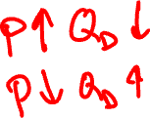
Determinants of demand
Four key determinants
Preferences
Prices and availability of related goods
Income
Number of consumers (for market demand)
“Law of Demand”
Quantity demanded is decreasing in price
Consumers vs. customers
Income does not apply to (B2B) customers

Slide 24

Individual demand
Suppose Jose’s preferences for Coke lead to the following decisions:
Price per can | Cans purchased
1.50 | 1
1.00 | 2
0.50 | 3
These decisions fit the demand function Q_{J} = 4 – 2P
Implies fractions of a can are OK

Slide 25
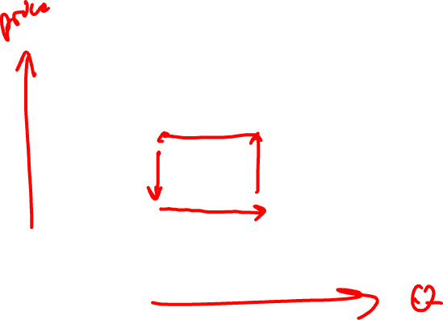
Individual demand: graphic
P
Jose’s demand for Coke can be written
Q_{J} = 4 – 2P
or
P = 2 – 0.5 Q_{J}
2
Jose’s demand curve
4
Q

Slide 26
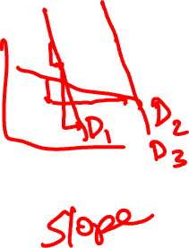
What drives individual demand?
Constrained optimization
Jose selects a combination of products to make himself as happy as possible, given
His limited resources
Prices he faces
Shape of demand
How Jose’s optimal quantity choice changes as price of Coke changes
Location of demand
As other factors change, Jose’s overall demand curve shifts

Slide 27
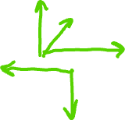
Individual demand: graphic
Example 1: (Red D₂)
Suppose consumers decide they really want to buy Coke
P
2
Example 2: (Tan D₃)
Suppose there is a recession, and consumers have less income
D₂
D₃
D₁
4
Q

Slide 28
Elasticity
What is an elasticity, and why do I care?
Measures sensitivity to changes in the environment
Ratio of percentage changes in a pair of related economic variables
Demand: Firms can calibrate consumers’ responses to their choices, competitors’ choices, and important related events
Supply: Firms can understand flexibility in their production processes

Slide 29
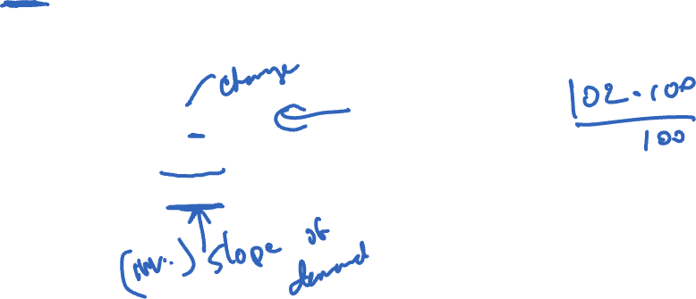
Demand elasticity
Own-price elasticity
Most common elasticity
How much will quantity demanded change when price changes by x%?
Definition
%ΔQ/%ΔP
(ΔQ/Q) / (ΔP/P) = (ΔQ/ΔP) x (P/Q)
(dQ/dP) x (P/Q)

Slide 30
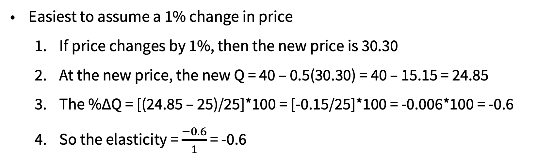
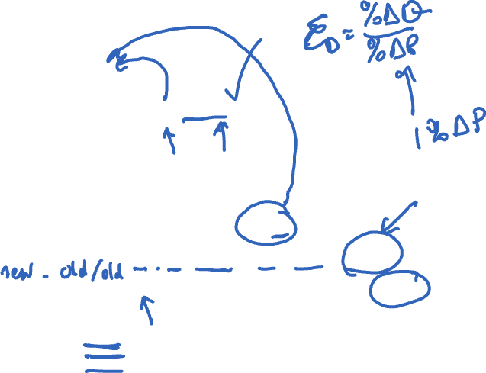
Demand elasticity: Example
Demand curve: Q = 40 – 0.5P
What is demand elasticity when P = 30, Q = 25?
Remember that elasticity = $\frac{\%∆Q}{\%∆P}$
Easiest to assume a 1% change in price
If price changes by 1%, then the new price is 30.30
At the new price, the new Q = 40 – 0.5(30.30) = 40 – 15.15 = 24.85
The %ΔQ = [(24.85 – 25)/25]*100 = [-0.15/25]*100 = -0.006*100 = -0.6
So the elasticity = $\frac{−0.6}{1}$ = -0.6

Slide 31
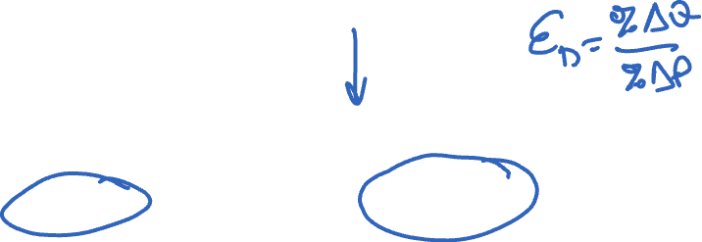
Evaluating demand elasticity
-∞
-1
0
Elastic
High sensitivity to price changes
If P↑, many customers will stop purchasing
Inelastic
Insensitivity to price changes
If P↑, relatively few customers will stop purchasing
Unit elastic

Slide 32

Demand elasticity: Illustrations
P
Which demand curve is more elastic at the intersection?
What does perfectly elastic demand look like?
D₂
D₁
Q

Slide 33
Agenda
Microeconomics
Demand
Supply
Competitive Markets

Slide 34
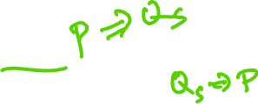
Supply decisions
Individual supply curve/ function
Describes a firm’s production decisions
How much it will produce at any price
Price it must receive to produce a certain amount
Outcome of profit maximization by competitive firms
Market supply curve
Describes the aggregate response of all relevant firms

Slide 35
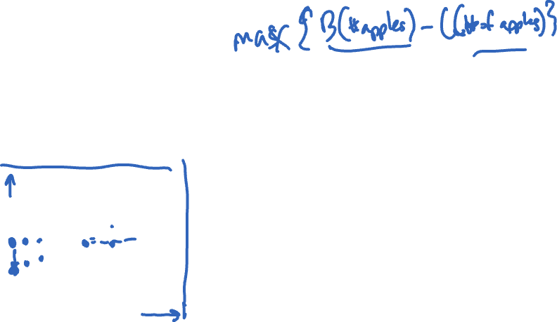
Supply decisions
Supply curves are illustrated as relationships between price (P) and quantity (Q)
P
S
When price increases from P₁ to P₂, supply curve tracks a firm’s optimal adjustment of Q
P₂
Movements along a supply curve are managerial decisions
The supply curve shifts when the manager’s environment changes
P₁
Q
Q₁
Q₂

Slide 36
Slope of supply curve
Generally upward
Firms choose to produce more when they receive a higher price
“Law of Supply”
Why?
Supply curves are determined by costs and production technology
Can be expensive to expand production scale
In the short run, may need to operate at inefficiently vigorous level (e.g., pay overtime)
Depends on...
Types of changes that can be made to production
Extent of possible changes is important when considering the difference between short- and long-run decisions

Slide 37
What affects supply?
Input prices
Labor
Raw materials
Technology
Quality and availability
Alternative product prices
As price of commercial construction rises, supply of residential construction falls
Supply of rental housing falls as price of owner-occupied housing increases

Slide 38
What affects supply?
Joint products
Price and supply of co-produced products
As demand for beef falls, supply of leather falls
# of firms
Market supply curve/ function
Time frame
When prices increase, firm will be able to increase supply more in the long run than in the short run
Note: most supply-shifting factors are outside a firm’s control
Things get more interesting (and difficult) when firms offer several related products

Slide 39
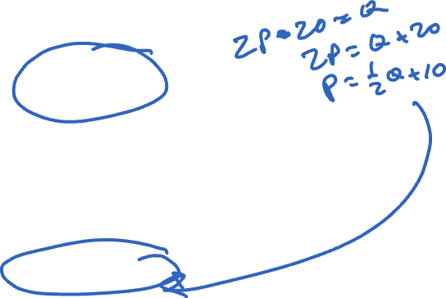
Supply curve examples
Suppose the supply function for dresses is:
Q = 2P – 20
Take price and learn how much would be produced in response
E.g., if P = 20, Q = 20
How do we interpret P = 5?
Alternative description of the same relationship is
P = 10 + 0.5Q
Price that would need to prevail for firms to sell Q units of output

Slide 40
Illustrating supply
P
Supply curve
P = 10 + 0.5Q
S
10
Q

Slide 41

Changes to supply
P
Example 1: (Red S₂)
Suppose additional firms enter the market
S₃
S₁
S₂
Example 2: (Tan S₃)
Suppose a labor shortage
10
Q

Slide 42
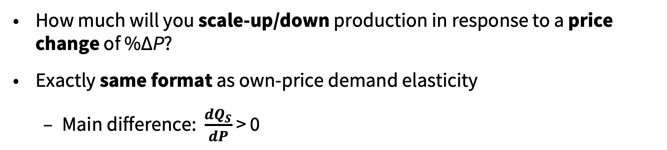

Supply elasticity
Measure of firms’ sensitivity to price changes
%ΔQ_{S}/%ΔP
(ΔQ_{S}/Q_{S}) / (ΔP/P) = (ΔQ_{S}/ΔP) x (P/Q_{S})
(dQ_{S}/dP) x (P/Q_{S})
Definition
How much will you scale-up/down production in response to a price change of %ΔP?
Exactly same format as own-price demand elasticity
Main difference: $\frac{dQ_{S}}{dP}$ > 0

Slide 43
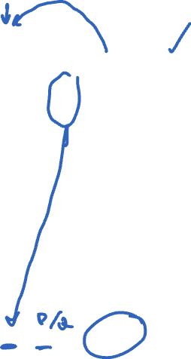
Supply elasticity: Example
Market supply curve: Q = 2P – 20
What is supply elasticity when P = 50, Q = 80?
Use our “other” formula: ε_{S} = $\frac{dQ_{S}}{dP}$ x $\frac{P}{Q_{S}}$
Need dQ_{S}/dP:
Look at the coefficient of P on the supply curve (2)
Consider an increase in price from P to (P + dP)
What is change in quantity (dQ)?
dQ = (2(P + dP) – 20) – (2P – 20)
dQ = 2dP, so dQ/dP = 2
Supply elasticity is ε_{S} = 2 x (50/80) = 1.25

Slide 44
Evaluating supply elasticity
0
1
∞
Inelastic
Insensitivity to price changes
Elastic
High sensitivity to price changes
Unit Elastic

Slide 45
Impact of time on supply elasticity
Time is one of the most important factors influencing supply elasticity
When a firm has more options to address market changes, it can make greater adjustments to quantity to adapt to these changes
Demand for autos increases
Short-run: More work shifts, more intense use of existing plants
Long-run: Hire more workers, build more plants

Slide 46

Supply elasticity: Illustrations
P
S₁
Which supply curve is more elastic at the intersection?
S₂
What does perfectly inelastic supply look like?
Q

Slide 47
Agenda
Microeconomics
Demand
Supply
Competitive Markets

Slide 48
Competitive markets: Assumptions
Four assumptions/conditions for a (perfectly) competitive market
Many consumers and firms
On both sides of the market
“Price takers”: No one has the power to unilaterally set prices
Assumptions are reinforcing
E.g., if firms collude or sell different products, wouldn’t be price takers
Common knowledge
The market has a free flow of information
A standardized (or homogenous) product
No collusion
Firms cannot explicitly cooperate to affect prices and quantities in the market
Free entry and exit
Firms enter and leave the market as they find it profitable (or necessary) to do so
Lack of technical/legal barriers for firms and consumers
Free markets in necessary inputs

Slide 49
Competitive markets: Evaluating the assumptions
Assumptions are very strong
Hard-pressed to find many markets with all these properties
Common examples of markets very close to ideal:
Agricultural markets
Some financial markets
Some labor markets

Slide 50
Competitive markets: Evaluating the assumptions
Intuition from competitive markets is very useful even when some assumptions do not hold
Depends on the level of analysis and what trying to achieve
Helpful
What will happen to the auto market following increase in demand for hybrid vehicles?
What is effect of improvements to hybrid production process?
Not so helpful
What happens to market for Ford F-150s if the vehicle failed a safety test?
Competitive markets an excellent place to start to understand markets

Slide 51
Market equilibrium
How demand and supply interact and generate economically meaningful activity
Recall we want to understand two key ideas
Optimization
Demand and supply curves describe optimizing behavior
Equilibrium
How demand and supply together yield prices and quantities

Slide 52

Market equilibrium: Example
Suppose we have the demand and supply curves:
Demand: Q^{D} = 260 – 20P or P = 13 – 0.05Q
Supply: Q^{S} = 32P – 104 or P = 3.25 + 0.03125Q
How would consumers and firms respond to a price of…
P = 8?
Q^{D} = 100 & Q^{S} = 152 What happens to this difference?
P = 6?
Q^{D} = 140 & Q^{S} = 88 What happens to this difference?
P = 7?
Q^{D} = 120 & Q^{S} = 120 Equilibrium!

Slide 53
Market equilibrium: Illustration
P
13
Equilibrium price and quantity where demand and supply intersect
S
7
3.25
D
Q
120
260

Slide 54
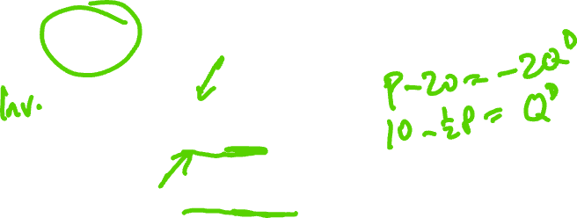
Finding competitive equilibrium
Identifying competitive equilibrium: Find price at which the quantity demanded equals quantity supplied
Put both the demand and supply curves in the form
Q = f(P)
Say you are given:
Demand P = 20 – 2Q^{D}
Supply Q^{S} = P – 5
The demand curve needs to be turned around to get the Q in front:
Q^{D} = 10 – 0.5P
The supply curve is already in the appropriate form

Slide 55

Finding competitive equilibrium
In equilibrium, it must be that Q^{S} = Q^{D}
So, set the equation for Q^{S} equal to the equation for Q^{D}
Q^{S} = Q^{D} = Q
or,
P – 5 = 10 – 0.5P
Solve for P
P – 5 = 10 – 0.5P
1.5P = 15
P = 10

Slide 56
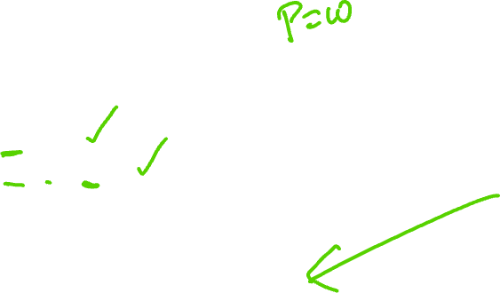
Finding competitive equilibrium
Substitute P into either demand or supply curve to find Q
As a check, substitute P into both
At P = 10, Q^{S} = 10 – 5 = 5
At P = 10, Q^{D} = 10 – 0.5x10 = 5
Equilibrium quantity is Q = 5
Could have set demand and supply in the form
P = f(Q)
then solved for Q first, then for P second

Slide 57

Finding equilibrium: Exercise
Find the equilibrium P and Q for the following demand and supply curves
Demand: P = 300 – 0.5Q^{D}
Supply: P = 0.25Q^{S} + 75
Illustrate the equilibrium in a graph
Put P on the vertical axis and Q on the horizontal axis, as usual

Slide 58
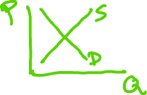
Predictions via equilibrium
Two kinds
Predict market outcomes when we know D and S
Predict how outcomes will change when D and/or S change
LASIK eye surgery
Some potential predictions to make
What if more corrective procedures were covered by insurance?
What if MO decided to crack down on drivers with poor eyesight?
What if laser equipment became cheaper to operate?
General predictions
Rough understanding allows general predictions about changes on P and Q
Precise forms of D & S yield better ones

Slide 59
Changes to equilibrium
Demand: Q^{D} = 260 – 20P
Supply: Q^{S} = 32P – 104
Eqm is P = 7 and Q = 120
P
15.6
13
S
What happens if D changes
Demand: Q^{D} = 312 – 20P
8
7
New equilibrium is
P = 8, Q = 152
D₂
3.25
D₁
Q
120
152
260
312

Slide 60
Changes to equilibrium
Demand: Q^{D} = 260 – 20P
Supply: Q^{S} = 32P – 104
Eqm is P = 7 and Q = 120
P
13
S₁
What happens if S changes
Supply: Q^{S} = 50.91P – 165.45
S₂
7
6
New equilibrium is
P = 6, Q = 140
D
3.25
Q
120
140
260

Slide 61
Changes to equilibrium
Suppose D and S both change
Demand: Q^{D} = 312 – 20P
Supply: Q^{S} = 50.91P – 165.45
P
15.6
13
S₁
New equilibrium is
P = 6.73, Q =177.33
Which directions of change could we have predicted in advance of the calculation?
S₂
7
6.73
D₁
D₂
3.25
Q
120
260
312
177.33

Slide 62
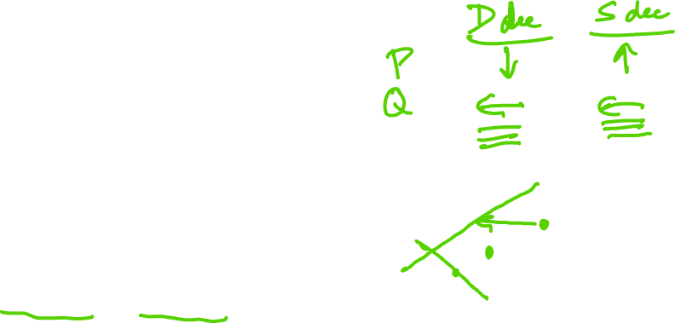
Predicting changes to equilibrium
P
What can be said about P and Q in the new equilibrium following…
D decrease only
S decrease only (# of suppliers decreases)
D increase and S decrease
D decrease and S decrease
S
D
Q

Slide 63
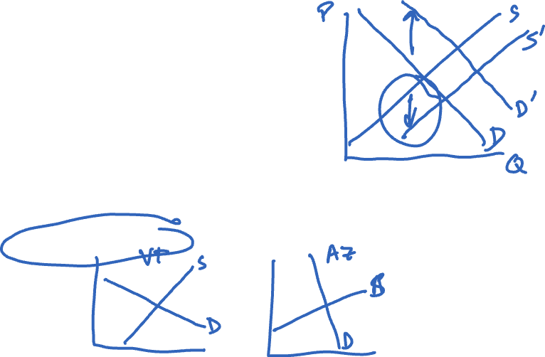
Example: Exosun
What has been happening to the tracker industry?
Demand side?
Supply side?
Which do you expect has grown more: supply or demand?
Why?
How would you incorporate regional variations into the standard model?
How do technology innovations and strong customer relationships affect the model?
Source: “Exosun in Receivership: The Latest in a Fast-Growing, Fiercely Competitive Tracker Market,” Independent, August 6, 2017

Slide 64
Market dynamics
Relative elasticities of demand and supply help tell us whether shocks will be translated primarily into changes in prices or quantities
Example
Housing prices in New York and Houston
Between 1977 and 2007, population in New York increased 15%, while the Houston’s population increased by about 100%
Increases in the demand for housing in both
What happened to housing prices in New York? Houston?

Slide 65
Relative elasticities matter
Original
Inelastic
D_{I}
D_{I}’
Elastic
P
S
D_{E}’
D_{E}
Q

Slide 66
Practical application
Economic concept
Practical business application
Demand curve
Market research
Number of customers
Total addressable market (TAM)
Consumer surplus
Leave money on the table
Customer analytics modeling
Elasticity
Sensitivity analysis

Slide 67
Agenda
Demand
Consumer surplus
Changes in demand
Elasticity

Slide 68
Why start with demand?
Essential part of firms’ success is how they relate to customers
Demand helps us understand what consumers will (and won’t) do
Motivation for firms’ product design and pricing choices
But we could also start with supply …
Follow the …

Slide 69
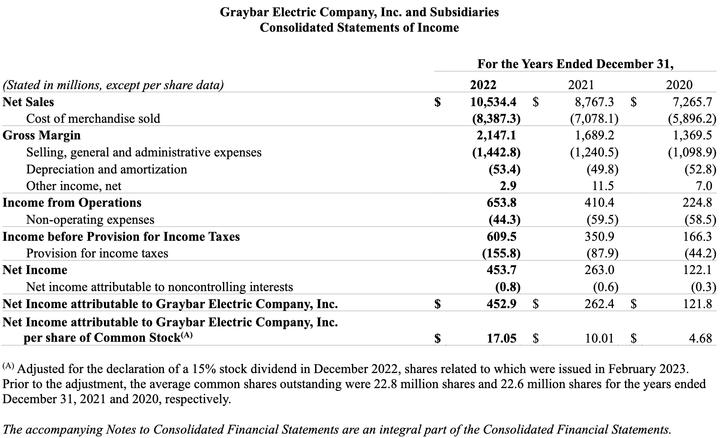
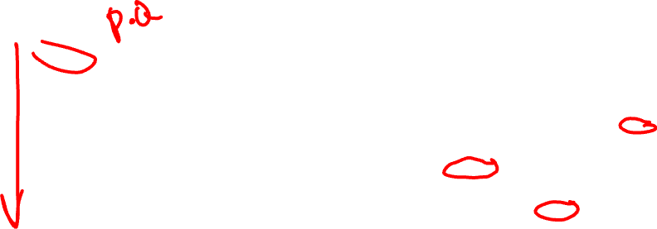
Follow the numbers!
Source: https://graybar.widen.net/s/bfq5zbhft5/secfilings-2022-12-31

Slide 70

Example: Demand for Coca-Cola
$$Q_{C}=26.17 −3.98P_{C}+2.25P_{P}+2.60A_{C } −0.62A_{P}+0.99I+9.58S$$
Q_{C} Quantity demanded of Coke (10 million cases)
P_{C} Price of Coke
P_{P} Price of Pepsi
A_{C} Ad expenditures by Coke
A_{P} Ad spend by Pepsi
I Household disposable income (thousands)
S Indicator for whether it is spring or summer
Sources: F. Gasmi, J.J. Laffont, Q. Vuong, “Econometric Analysis of Collusive Behavior in a Soft-Drink Market,” Journal of Economics and Management Strategy, June 1992; Viktaur, Public domain, via Wikimedia Commons (https://commons.wikimedia.org/wiki/File:Coca-Cola_bottle_cap.svg)

Slide 71
Components of demand
$$Q_{C}=26.17 −3.98P_{C}+2.25P_{P}+2.60A_{C } −0.62A_{P}+0.99I+9.58S$$
Why does it make sense to include P_{C} (–) and P_{P} (+)?
What does the (+) coefficient on I indicate? S?
How do we interpret the coefficients on A_{C} (+) and A_{P} (–)?
Is there anything important missing from this model?
This model was estimated in 1992; what do you think is different today?
Sources: F. Gasmi, J.J. Laffont, Q. Vuong, “Econometric Analysis of Collusive Behavior in a Soft-Drink Market,” Journal of Economics and Management Strategy, June 1992; Viktaur, Public domain, via Wikimedia Commons (https://commons.wikimedia.org/wiki/File:Coca-Cola_bottle_cap.svg)

Slide 72
Determinants of demand
Demand
Defined at both the individual and market level
Four key determinants
Preferences
Prices and availability of related goods
Income
Number of consumers (for market demand)
“Law of Demand”
Quantity demanded is decreasing in price

Slide 73
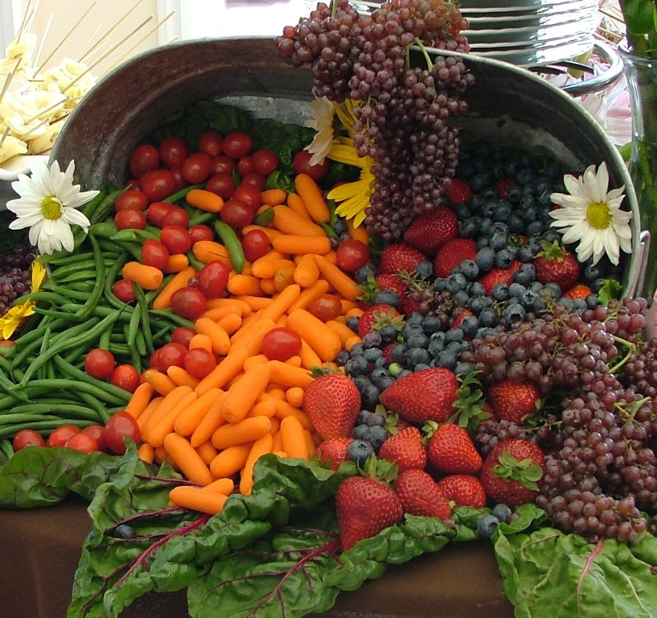
Income and substitution effects
Income effect
Price for carrots ↓
Can still buy everything in basket
€ left over
Buy more carrots
Substitution effect
Price for carrots ↓
Carrots (relatively) cheaper than other food
Buy more carrots
Source: Jina Lee, CC BY-SA 3.0 <https://creativecommons.org/licenses/by-sa/3.0>, via Wikimedia Commons (https://commons.wikimedia.org/wiki/File:Cornucopia_of_fruit_and_vegetables_wedding_banquet_(cropped).jpg)

Slide 74
Income and substitution effects: graphic
P
Price Drops
Income Effect
Substitution Effect
Q

Slide 75

Relationship of price and quantity
Very important: 1-to-1 relationship between prices and quantities
Q_{J} = 4 – 2P
P = 2 – 0.5 Q_{J}
Can interchange the two concepts when discussing optimal firm decisions
“What’s the best quantity (what is the maximum quantity/ amount customers will buy) at a given price?”
“What’s the best price (what is the maximum customers are willing to pay) for a particular quantity/amount?”

Slide 76

Example: Disney
Why do the theater owners want to lower the price of tickets?
Why are there different ticket prices in different cities?
Why is Disney able to enforce these pricing schemes, while other studios aren’t?
Source: “Disney, Theater Operators Battle Over New ‘Avengers’” May 4, 2015

Slide 77
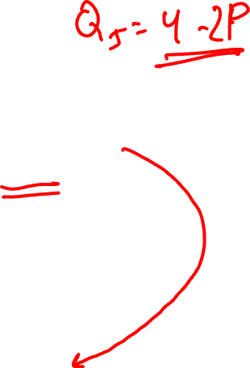
Market demand
Katya
Second person in the Coke market
Preferences (and circumstances) yield a different demand curve
Q_{K} = 3 – P
Katya + Jose
Total demand for this small Coke market is sum of their demand curves
Total quantity demanded at price P’ is
Q = Q_{J}(P’) + Q_{K}(P’)
Market demand curve is
Q = 7 – 3P
if both Jose and Katya purchase Coke

Slide 78
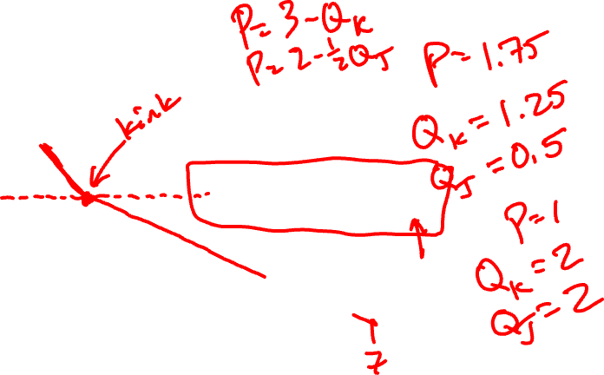
Market demand: graphic
P
Jose: Q_{J} = 4 – 2P
3
Katya: Q_{K} = 3 – P
Market: Q = 7 – 3P if P < 2
Q = 3 – P if P ≥ 2
2
3
4
7
Q
Market demand curves: Aggregated choices of all individuals in a market

Slide 79
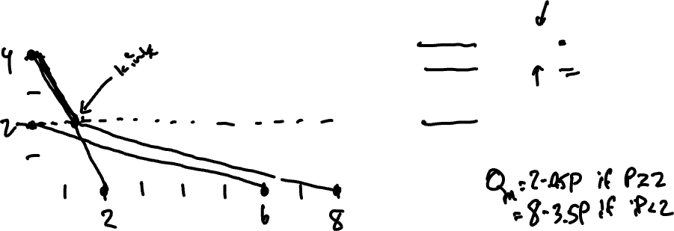
Market demand: example
P
Xiuying: Q_{X} = 6 – 3P
Jayanti: Q_{J} = 2 – 0.5P
Market: Q = ??? if P < ???
Q = ??? if P ≥ ???
Q

Slide 80
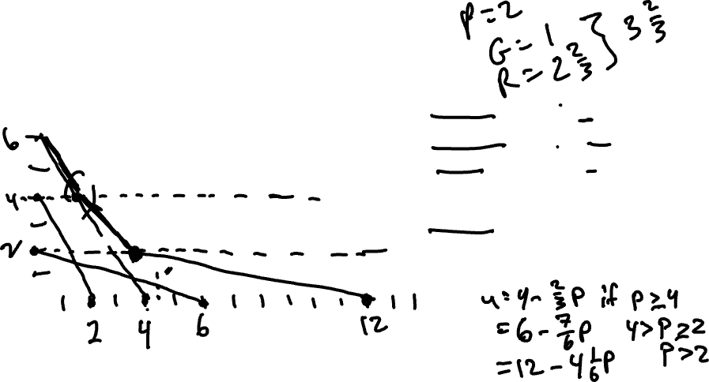
Market demand: example
P
Antonia: Q_{A} = 6 – 3P
Gabriela: Q_{G} = 2 – 0.5P
Rosita: Q_{R} = 4 – (2/3)P
Market: Q = ??? if P ≤ ???
Q = ??? if ??? < P ≤ ???
Q = ??? if ??? < P
Q

Slide 81
Agenda
Demand
Consumer surplus
Changes in demand
Elasticity

Slide 82
Consumer surplus
Bargain!
What does it mean?
Pay less than you were willing to
This difference is called consumer surplus
Jose @ $0.50/can
Jose’s benefit? (Remember, P = 2 – 0.5 Q_{J})
Would have bought 1st can for $1.50 (but didn’t have to)
Would have bought 2nd can for $1.00 (but didn’t have to)
Total benefit
$1 from the 1st can and $0.50 from the 2nd?
Not quite – Jose actually does better

Slide 83
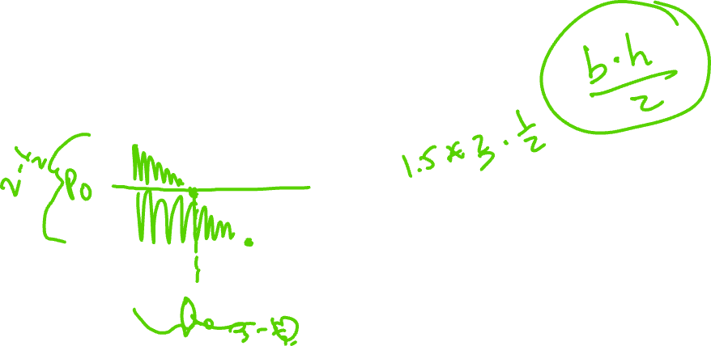
Consumer surplus: graphic
Jose’s consumer surplus is the area under his demand curve
Accounts for his benefit from each incremental drop of Coke
P
Consumer surplus = $2.25
(Area of aqua triangle)
2
Suppose Jose was made a take-it-or-leave-it offer for 3 cans of Coke
How much would he pay?
0.5
3
4
Q

Slide 84
Managerial implication of consumer surplus
Represents overall consumer satisfaction with product or service
Note potential difference in surplus when demand changes at optimal Q
P
Q
Need more complicated pricing strategies to capture surplus

Slide 85
Agenda
Demand
Consumer surplus
Changes in demand
Elasticity

Slide 86
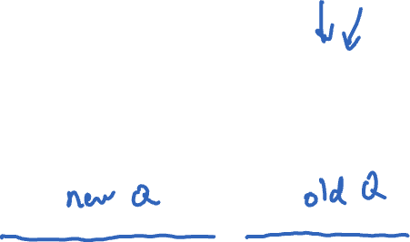
Changes in demand: price
How does demand change as price and other factors change?
Consider demand for air travel
Q = 25 + 3Y + P⁰ – 2P
P is price, Y is income, P⁰ is a competitor’s price
What is the effect of a small change in price (dP) on Q?
dQ = Change in quantity demanded
= [25 + 3Y + P⁰ – 2(P+dP)] – [25 + 3Y + P⁰ – 2P]
= [25 + 3Y + P⁰ – 2P – 2dP)] – [25 + 3Y + P⁰ – 2P]
= –2dP
dQ/dP = –2

Slide 87
Changes in demand: other factors
Go back to the demand curve
Q = 25 + 3Y + P⁰ – 2P
We saw
dQ/dP = –2
We can also figure out
dQ/dP⁰ = 1
dQ/dY = 3
Simply reading coefficients off the demand curve (the numbers in front of each variable)
This is our formula for a derivative…

Slide 88
Changes in demand
Response to own price
Negative
Increase in price → reduction in quantity
Almost all goods have this property
“Law of Demand”
Consumer’s perspective
Small increase in price makes last unit of consumption unattractive
May choose to spend money elsewhere

Slide 89
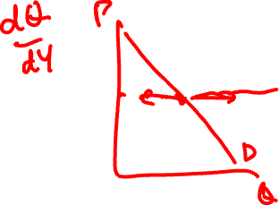
Changes in demand
Response to income
Normal goods
Demand increases as income increases
Most goods have this property
Inferior goods
Demand decreases as income increases
Examples?
Luxury goods
Demand increases rapidly as income increases
Increasing proportion of income is spent on them
Examples?

Slide 90
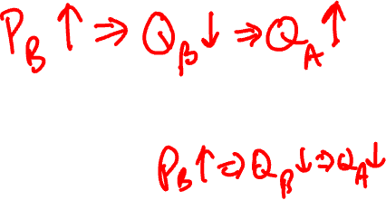
Changes in demand
Response to related goods
Substitutes
Buy more of good A if price of B rises
Complements
Buy less of good A if price of B rises
Examples
Gin and tonic
Video games and DVDs
Tires and autos
Cornflakes and eggs

Slide 91
Illustrating changes in demand
Return to demand
Q = 25 + 3Y + P⁰ – 2P
Let’s assume Y = 105 and P⁰ = 240
So…
Q = 580 – 2P
or
P = 290 – 0.5Q
Generally work with the second form

Slide 92
Illustrating changes in demand
P
Start with demand
P = 290 – 0.5Q
305
290
What if income changes to 115?
P = 305 – 0.5Q
270
What if P⁰ changes to 200 (Y = 105)?
P = 270 – 0.5Q
540
580
610
Q

Slide 93
Summary of changes
Movement along
Change in the price
Change in quantity demanded
Shift of curve
Change in income, other prices, or any other variable
Change in demand (curve)
Questions
A higher price for Sam Adams has what kind of impact on the demand curve for Schlafly’s?
What’s the impact of a higher price for Schlafly’s on the demand curve for Schlafly’s?

Slide 94

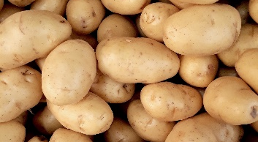
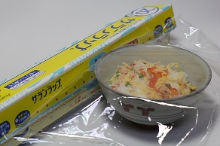

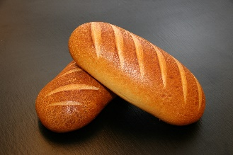


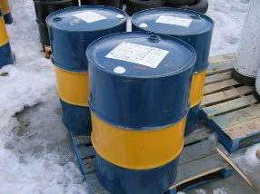
Examples
How will the demand curve of good x respond to an increase in y?
x
y
Vacations
Income
Potatoes
Income
Saran wrap
Gladware prices
Bread
Atkins trend
Hummer
Oil prices
Notes:
Photo by Rebeca Gonçalves: https://www.pexels.com/photo/person-laying-on-sand-1770310/
Photo by Marco Antonio Victorino: https://www.pexels.com/photo/photo-of-pile-of-potatoes-2286776/
Kakura, CC BY-SA 3.0 <https://creativecommons.org/licenses/by-sa/3.0>, via Wikimedia Commons (https://commons.wikimedia.org/wiki/File:Saran_Wrap_02.JPG)
Clorox, Stepshep at English Wikipedia, Public domain, via Wikimedia Commons (https://commons.wikimedia.org/wiki/File:Glad_logo.svg)
Photo by Pixabay: https://www.pexels.com/photo/baked-bread-breakfast-buns-209206/
https://shop.atkins.com/
Photo by Jacob Moore: https://www.pexels.com/photo/a-high-mobility-multi-purpose-wheeled-vehicle-parked-in-the-roadside-10981341/
Trevor MacInnis, CC BY-SA 2.5 <https://creativecommons.org/licenses/by-sa/2.5>, via Wikimedia Commons (https://commons.wikimedia.org/wiki/File:Fuel_Barrels.JPG)

Slide 95
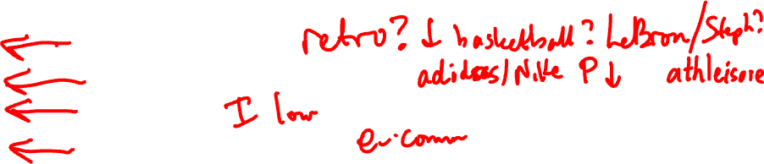
Example: Under Armour
What are the reasons for Under Armour’s changing demand?
Preferences?
Price of alternative products?
Income?
Number of consumers?
Source: “Layoffs, restructuring and losses hit Under Armour as America’s malls fade away” August 6, 2017

Slide 96
How do we learn the details of demand?
Marketing surveys
Ask people what they’d pay
What people say and do can be different
Price experimentation
Test effects of small changes in markets
Actual consumers responses to changes in own price
Have to control other factors that affect demand
Econometric studies
Examine historical demand data
Can be very tricky to do properly
Ideally, we would like to trace out a demand curve, but have to control for other reasons why P and Q vary

Slide 97
What’s the value of learning demand?
Incumbent firm (in the market)
What is the best price (or quantity) to select?
What changes customers’ demand when my competitor changes prices?
Potential entrant (e.g., entrepreneur)
What markets are underserved or not yet served by current firms?
Will revenue be strong enough to cover costs?

Slide 98
Agenda
Demand
Consumer surplus
Changes in demand
Elasticity

Slide 99
Demand elasticity
Own-price elasticity
What is percentage change in quantity demanded when price changes by x%?
Formulas
%ΔQ_{D}/%ΔP
(ΔQ_{D}/Q_{D}) / (ΔP/P) = (ΔQ_{D}/ΔP) x (P/Q_{D})
(dQ_{D}/dP) x (P/Q_{D})

Slide 100
Calculating elasticity
Return to the demand curve
Q_{D} = 580 – 2P
We saw earlier that dQ_{D}/dP = –2
What does this tell us about consumers’ price sensitivity?
If P = 200, what is Q_{D}?
180
If P increases by 1%, what is the new Q_{D}?
New P = 202, so new Q_{D} = 176
What is elasticity of demand?
%Δ in P = 1%, and %Δ in Q_{D} = –2.2%, so ε_{D} = –2.2

Slide 101
Evaluating elasticity
-∞
-1
-1
0
Elastic
High sensitivity to price changes
If P↑, many customers will stop purchasing
Inelastic
Insensitivity to price changes
If P↑, relatively few customers will stop purchasing
Unit elastic

Slide 102
Elasticity changes along (linear) demand curve
P
Demand: Q_{D} = 580 – 2P
Elasticity
At P = 100, ε_{D} = -0.53
At P = 145, ε_{D} = -1
At P = 200, ε_{D} = -2.2
290
ε_{D} = -2.2
200
ε_{D} = -1
145
ε_{D} = -0.53
100
580
Q

Slide 103
What determines elasticity?
Similarity of substitutes
iPhone v. digital camera
Market definition
Coke v. all soda v. all drinks
Italian restaurants in Clayton v. in St Louis
Timeframe
Short-run v. long-run effects of increase in gas prices on gasoline quantity
Importance/ frequency
5% increase in car price v. Starbucks venti latte
Tastes
Under Armour v. Nike
https://www.dailymotion.com/video/x3id8ro
Notes:
LeBron James: “Who? Who? Who is that? ... I don’t know what you’re talking about. Who? The other guys ... I don’t know who Under Armour is. What are you talking about? Who? ... I only know Nike. Lifetime.” December 2015 (https://www.youtube.com/watch?v=95L1zxQjeqw)

Slide 104



Elasticity examples
Air travel
Tobacco
Gasoline
Business: -1.15
Short run: -0.46
Short run: -0.20
Leisure: -1.52
Long run: -1.89
Long run: -0.60
Notes:
Photo by cottonbro studio: https://www.pexels.com/photo/man-in-white-and-gray-pinstripe-dress-shirt-holding-clear-glass-mug-6700131/
Photo by Basil MK: https://www.pexels.com/photo/close-up-photo-of-cigarette-ashes-247040/
Photo by Andrea Piacquadio: https://www.pexels.com/photo/woman-in-yellow-shirt-while-filling-up-her-car-with-gasoline-3812750/

Slide 105
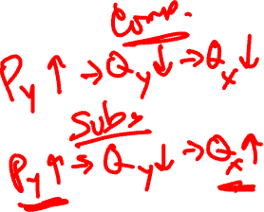
Cross-price elasticity
How does quantity of good X change with price of good Y?
Formulas
%ΔQ_{X}/%ΔP_{Y}
(ΔQ_{X}/Q_{X}) / (ΔP_{Y}/P_{Y})
(dQ_{X}/dP_{Y}) x (P_{Y}/Q_{X})
Important tool in evaluating whether two products are in the same market
Identifying competitors
Antitrust cases

Slide 106




Cross-price elasticity: Examples
 | Auto with price change
 | Sentra | Escort | BMW 735
Sentra | -6.53 | 0.08 | 0.00
Escort | 0.45 | -6.03 | 0.00
BMW 735 | 0.00 | 0.00 | -3.51
Notes:
Nissan Motor Corporation, CC BY-SA 4.0 <https://creativecommons.org/licenses/by-sa/4.0>, via Wikimedia Commons (https://upload.wikimedia.org/wikipedia/commons/thumb/8/8c/Nissan_logo.png/2048px-Nissan_logo.png)
Ford Motor Company, Public domain, via Wikimedia Commons (https://commons.wikimedia.org/wiki/File:Ford-Motor-Company-Logo.png)
BMW, Public domain, via Wikimedia Commons (https://commons.wikimedia.org/wiki/File:BMW.svg)

Slide 107

Income elasticity
How does the quantity of good X change with income (I)?
Formulas
%ΔQ_{X}/%ΔI
(ΔQ_{X}/Q_{X}) / (ΔI /I)
(dQ_{X}/dI) x (I /Q_{X})
Normal goods: ε_{I} > 0
Inferior goods: ε_{I} < 0
Which products will grow most as markets grow and people become wealthier?

Slide 108

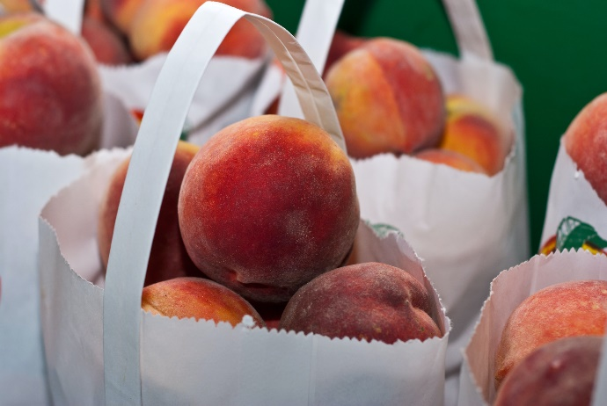
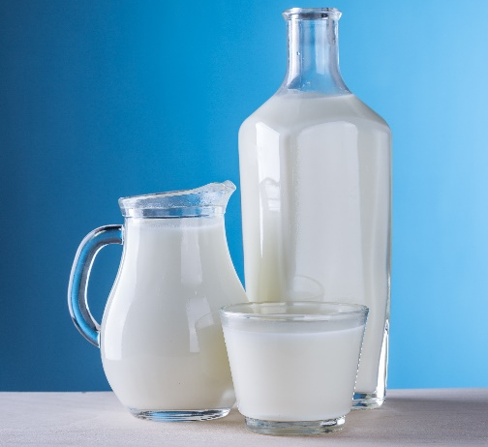
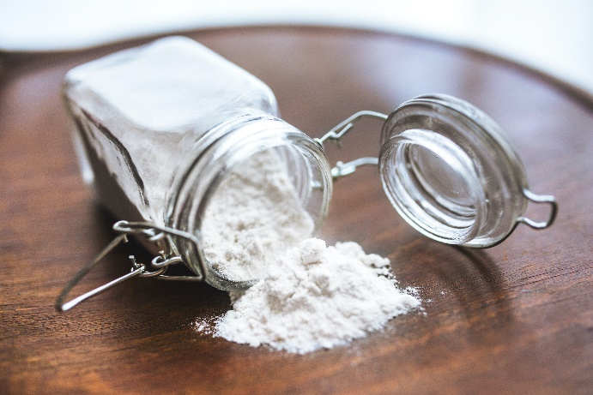
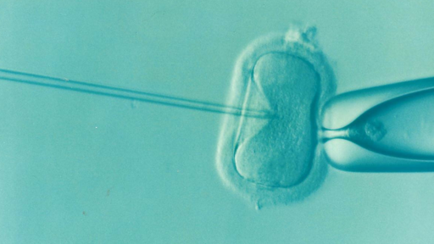
Income elasticity: Examples
2.59
1.43
0.50
-0.36
1.32
Notes:
Photo by Timur Saglambilek: https://www.pexels.com/photo/wine-glass-with-red-liquid-on-black-table-66636/
Photo by Mark Stebnicki: https://www.pexels.com/photo/pile-of-bags-of-peaches-2253534/
Photo by Pixabay: https://www.pexels.com/photo/close-up-of-milk-against-blue-background-248412/
Photo by Kaboompics .com: https://www.pexels.com/photo/flour-in-a-jar-5765/
DrKontogianniIVF, CC0, via Wikimedia Commons (https://commons.wikimedia.org/wiki/File:Ivf.png)

Slide 109
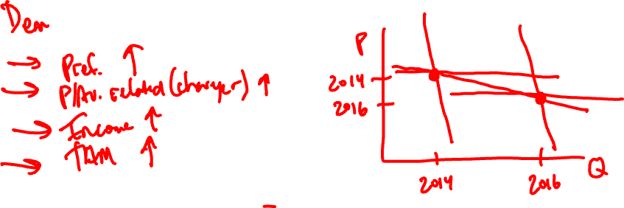
Example: Tesla
What is the argument the author makes to explain the increase in revenue?
Revenue = P*Q
Is there another explanation for the growth in revenue that does NOT rely on elastic demand?

Slide 110
Relative elasticities matter
Inelastic
Elastic
D_{I}
P
D_{E}
Q

Slide 111
Examples of behavioral biases: Demand
Decoy effect
Consumers switch choices when a third (worse) option is added
Related to the “independence of irrelevant alternatives”
Ex: Ariely’s Economist.com experiment
Web ($59) 68%, print & web ($125) 32%
Web ($59) 16%, print & web ($125) 84%, print ($125) 0%
Endowment effect
Willingness to pay (acquire) less than willingness to accept (give up)
Related to loss aversion
Ex: Kahneman, Knetch & Thaler’s mug experiment
Hyperbolic discounting
People prefer rewards sooner rather than later
Ex: I’ll buy fruit for this week, but buy a candy bar to eat today
Choice-supportive
Remember choices as better than they were (emphasize positive benefits of chosen option)
Social influencers?

Slide 112
Demand, consumer surplus and elasticity: Summary
Demand
Market demand aggregates optimal choices of individuals
Predicts purchasing choices
Includes responses to all relevant changes in the market
Consumer surplus
Quantifies happiness
Difference between willingness to pay and actual price
Firms use pricing strategies to capture some of this surplus
Elasticity
Sensitivity of consumers’ choices to changes in prices and income
Helps understand optimal pricing

